Slide 1
ASSIGNMENT LEAD SCORE CASE STUDY LOGISTIC REGRESSION
By :- Priyanka/ Supriya/ Siva

Slide 2
Lead score case study for x education
Problem Statement :
X Education Sells Online Courses To Industry Professionals. The Company Markets It’s Courses On Several Websites And Search Engines Like Google.
Once These People Browse The Courses Or Fill Up A Form For The Courses Or Watch Some Videos When Theses People Fill Up A Form Providing There E Mail Address Or Phone No. They Are Classified To Be A Lead Moreover The Company Also Gets Leads Through Pas Referrals.
Once These Leads Are Acquired Employees From The Sales Team Start Making Call Writing Emails Etc Through This Process Some Of The Leads Get Converted While Most Do Not The Lead Conversation Rate At X Education Is Around 30%
BUSINESS GOALS:
X Education Needs Help In Selcting The Most Promising Leads That’s The Leads That Are Most Likely To Convert Into Paying Customers
The Company Needs A Model Where You A Leads Core Is Assingned To Each Of The Leads Such That The Customers With Higher Leads Score Have A Higher Conversion Chance And The Customers With Lower Lead Score Have A Lower Conversion Chance
The Ceo In Particular Has Given A Ball Park Of The Target Lead Conversion Rate To Be Around 80%

Slide 3
Strategy:-
Source The Data For Analysis.
Clean And Prepare The Data.
Exploratory Data Analysis.
Feature Scaling.
Splitting The Data Into Test And Train Dataset.
Building A Logistic Regression Model And Calculate Lead Score.
Evaluating The Model By Using Different Metrics – Specificity And Sensitivity Or Precision And Recall.
Applying The Best Model In Test Data Based On The Sensitivity And Specificity Metrics.

Slide 4
Problem Solving Methodology
Data sourcing, cleaning and preparation
Read the data from the source
Convert data into clean format suitable for analysis
Remove duplicate data
Outlier treatment
Exploratory analysis
Feature standardisation
Feature scaling and splitting train and test sets
Feature scaling of numeric data
Splitting data into train and test set.
Model Building
Feature Selection Using RFE
Determine The Optimal Model Using Logistic Regression.
Calculate Various Metrics Like Accuracy, sensitivity, Specificity, Precision And Recall And Evaluate The Model.
Result
Determine the lead score and check if target final predictions amounts to 80% conversion rate.
Evaluate the final prediction on the test set using cut off threshold from sensitivity and specificity metrics.

Slide 5
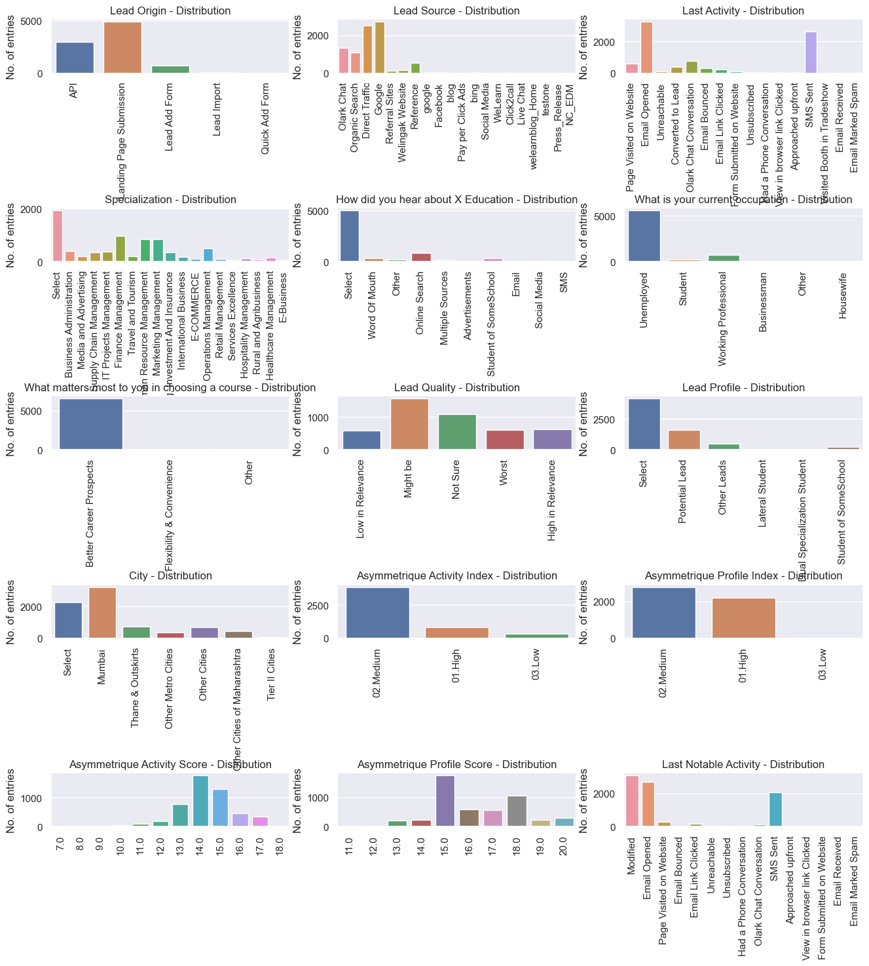
Check the distribution of Categorical variables

Slide 6
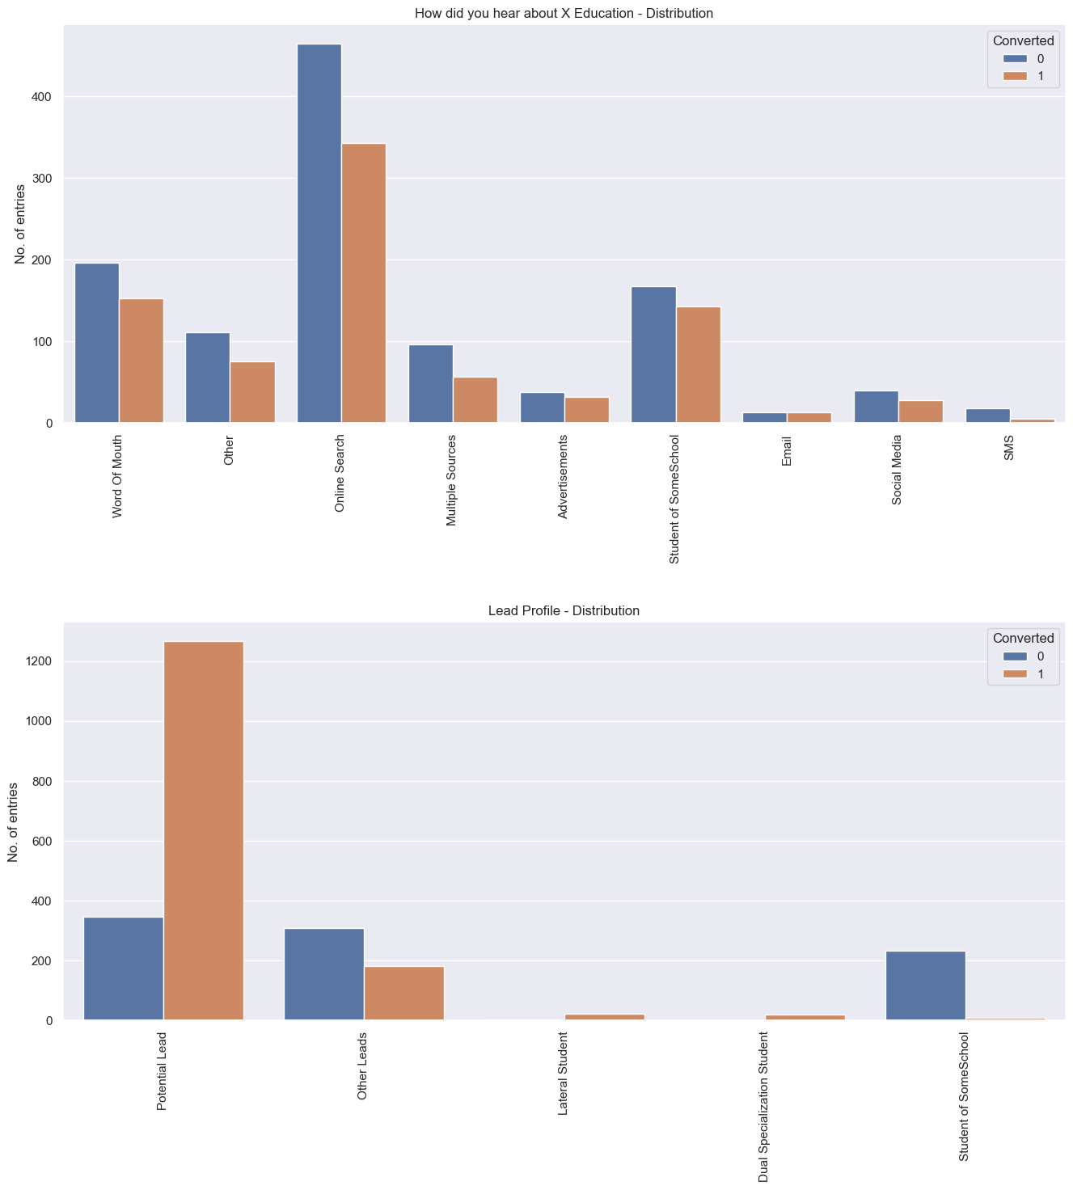
# Check the variables with very high NULL values

Slide 7
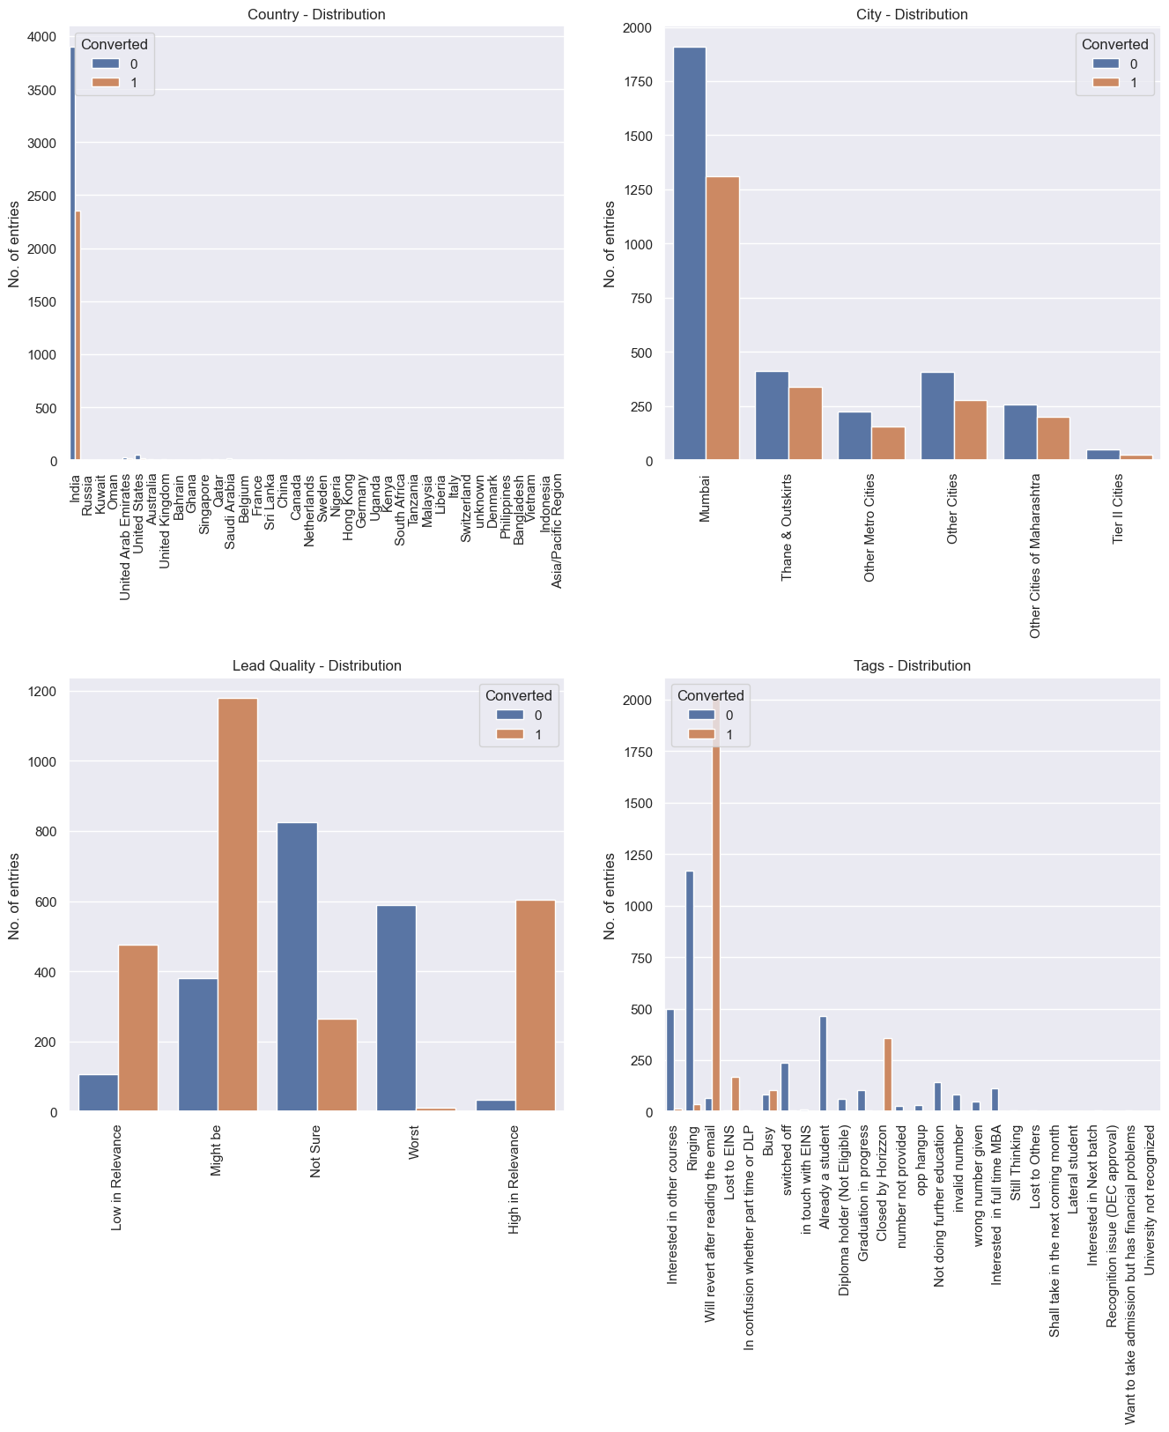
Drop the Asymmetric columns with score values

Slide 8
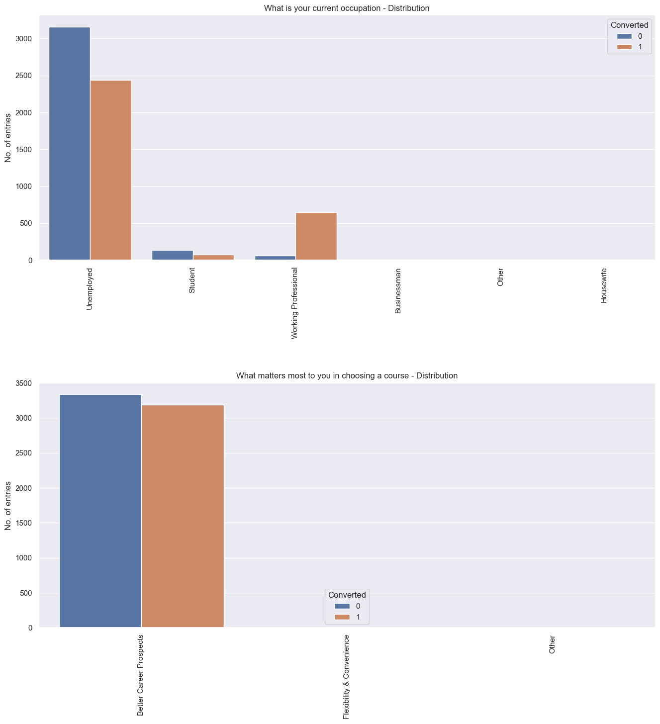
distribution of all categorical variables

Slide 9
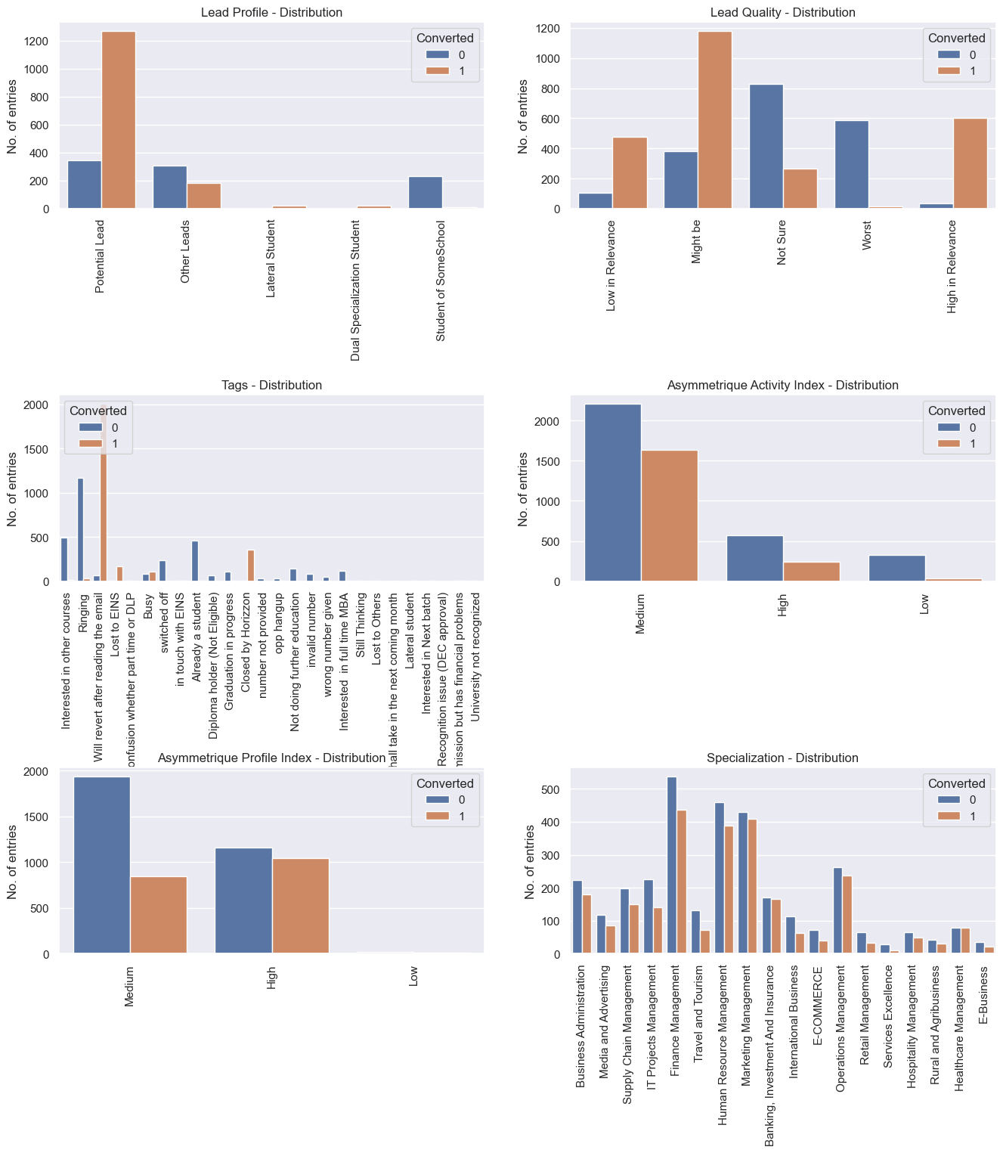
Check and start cleaning of remaining categorical variables

Slide 10
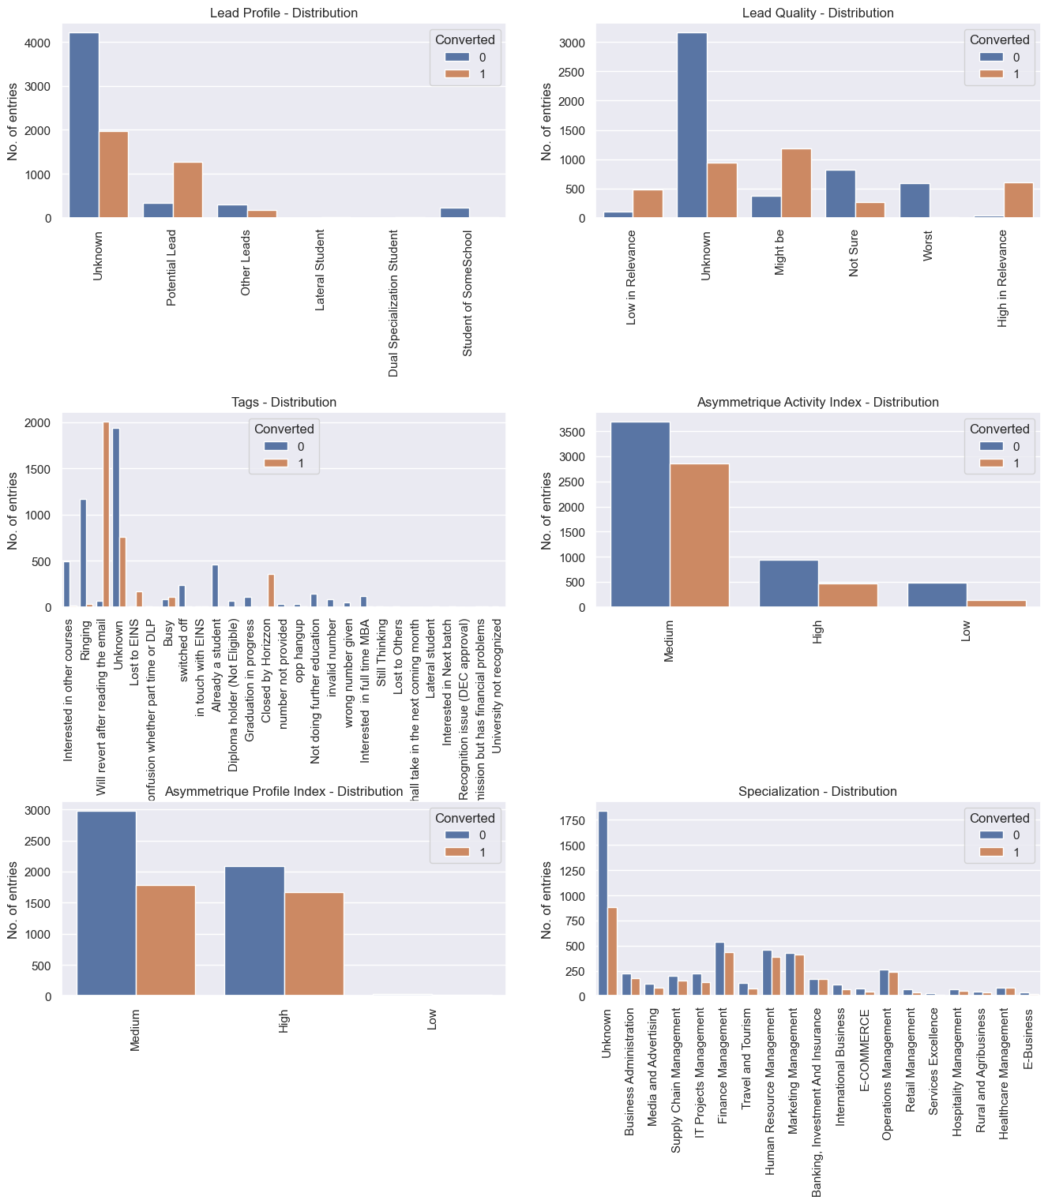
Check the column distribution after changes

Slide 11
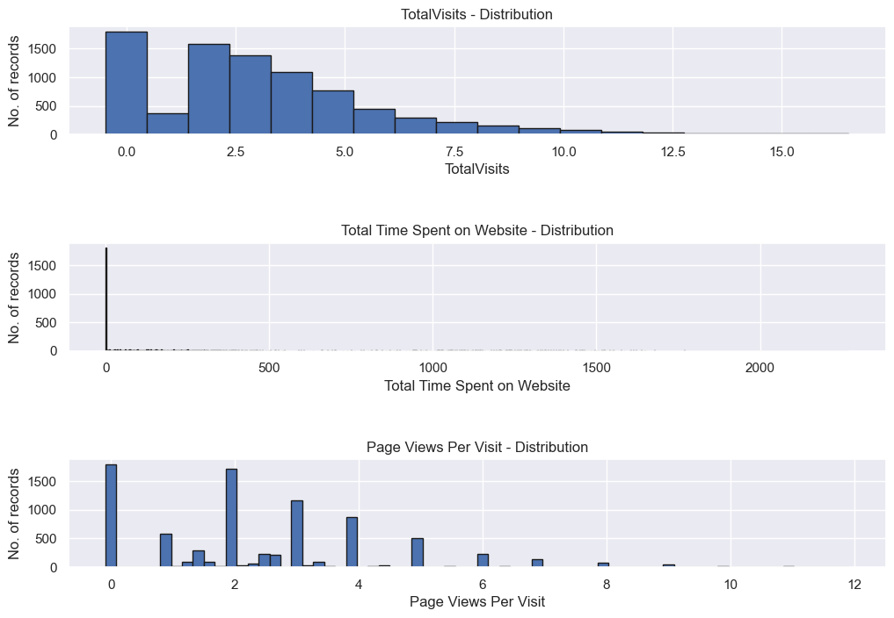
Exploratory data analysis
Total time spent on websites and page views per visits. Visualizing the histogram of the distribution of all numeric variables
Visualizing the histogram of the distribution of all numeric variables after outlier treatment

Slide 12
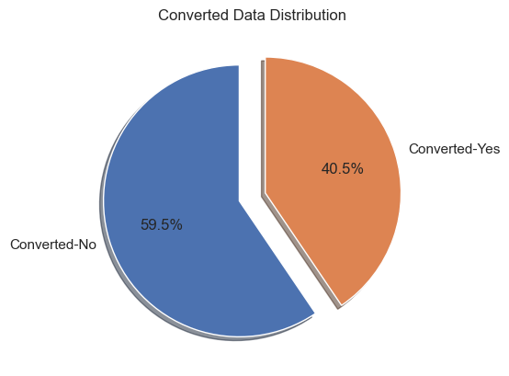
Exploratory data analysis
We have around 40.5% conversion rate in total.

Slide 13
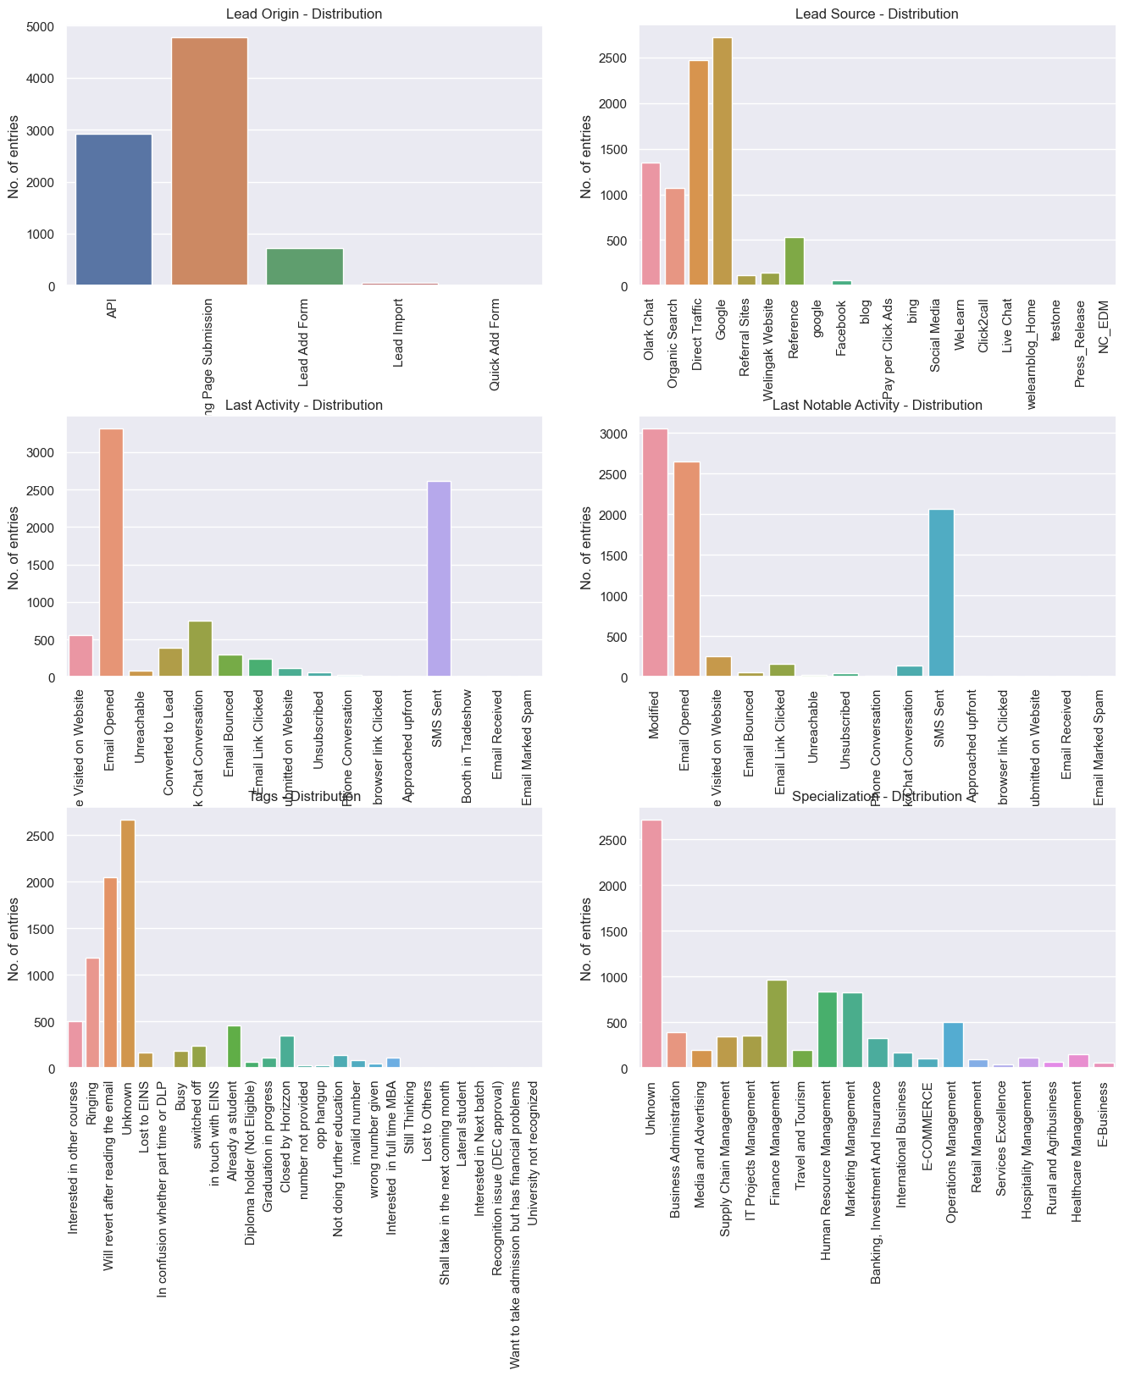

Check the values in the categorical variables and group the minor values into one single dummy value

Slide 14
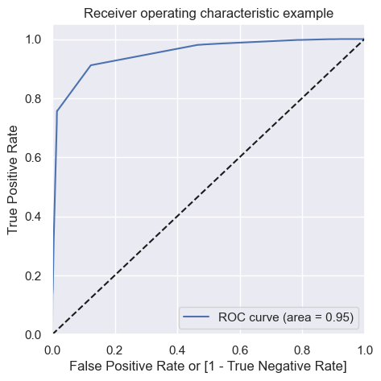
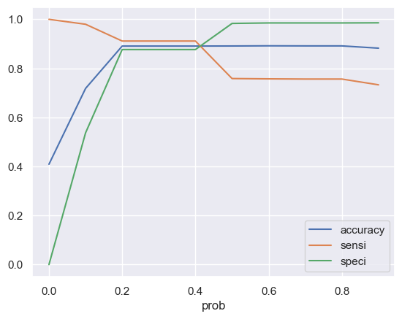
ROC CURVE:-
create columns with different probability cutoffs
The MODEL has Area Under Curve (AUC) value of 0.95, which is a very good indicator
The various cutoff are plotted and 0.4 is where all values are converging. Let's re-calculate the final predicted values using 0.4 as threshold.

Slide 15
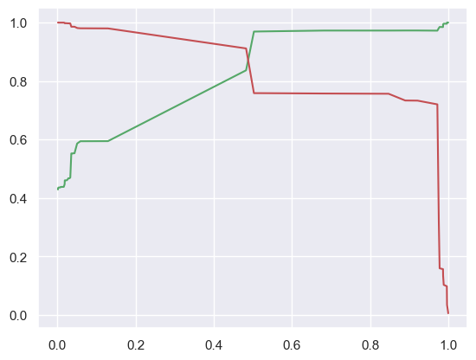
Part 1F. Precision and Recall
After plotting the graph we did below actions :-
Test Data Predictions
Transform the test data
Add constant to test data before predictions
Create y_test predictions
Converting y_pred to a dataframe from an array
Converting y_test to dataframe
Create Test Data Confusion Matrix
Precision Score of the Test Data Predictions: 82.99 %
Recall Score of the Test Data Predictions: 91.56 %
Accuracy of the Test Data Predictions: 89.23 %

Slide 16
Conclusion:-
While we have checked both sensitivity-specificity as well as precision and recall metrics, we have considered the optimal cut off based on sensitivity and specificity for calculating the final predictions:-
Accuracy, Precision score, Recall score values of test set are around 89.23%, 82.99% and 91.56% which are approximately closer to the respective values calculating using trained set.
The top 3 variables that contribute for lead getting converted in the model are
Total time spent on website
Lead add form from lead origin
Had a phone conversion from last notable activity
Hence overall this model seems to be good.

Slide 17


Thank you

